Slide 1

GROUP ASSIGNMENT 02: WORLD HEALTH
GROUP E
FAHAD ALSALEH MAZEN AL-HABIB FATIMAH ALALI
FAHAD ALFASSAM AHMED ALMUTAWA MATTER ALOTAIBI
DURRAH ALZAMIL OTHMAN OTAIBI

Slide 2
Data Set at a Glance
Lists countries and indicators of their safety, health, pollution, etc.
Data recorded at different points in time, non-uniform across indicators.

Slide 3
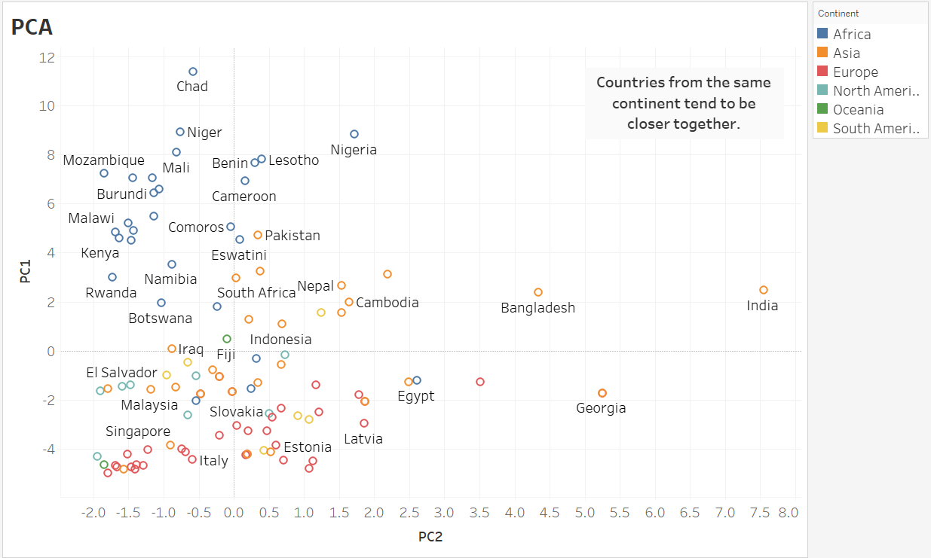

Slide 4
Global Overview

Slide 5

TOBACCO USE
Percentage of smokers decreases over time in many countries

Slide 6
TOP 10 COUNTRIES OVER THE YEARS

Slide 7
Harmful Behavior

Slide 8
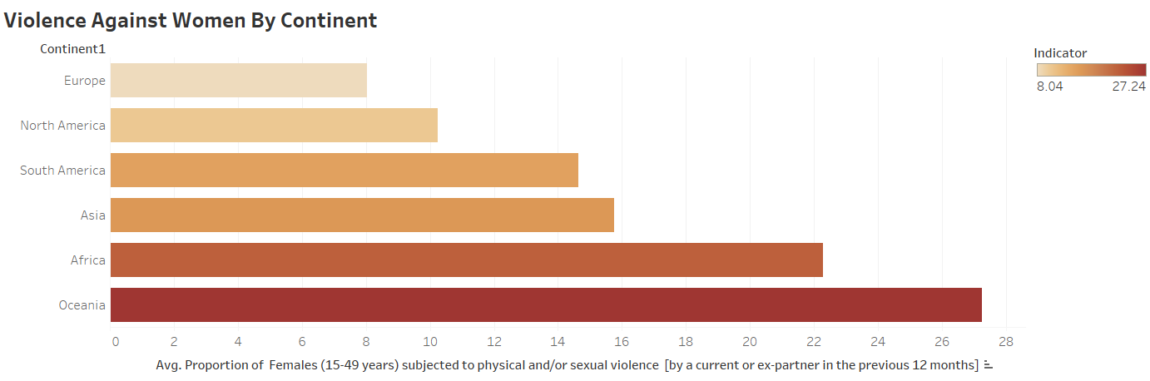
Violence to Women by Partners (current & Ex)
Oceania scores the highest in this indicator

Slide 9
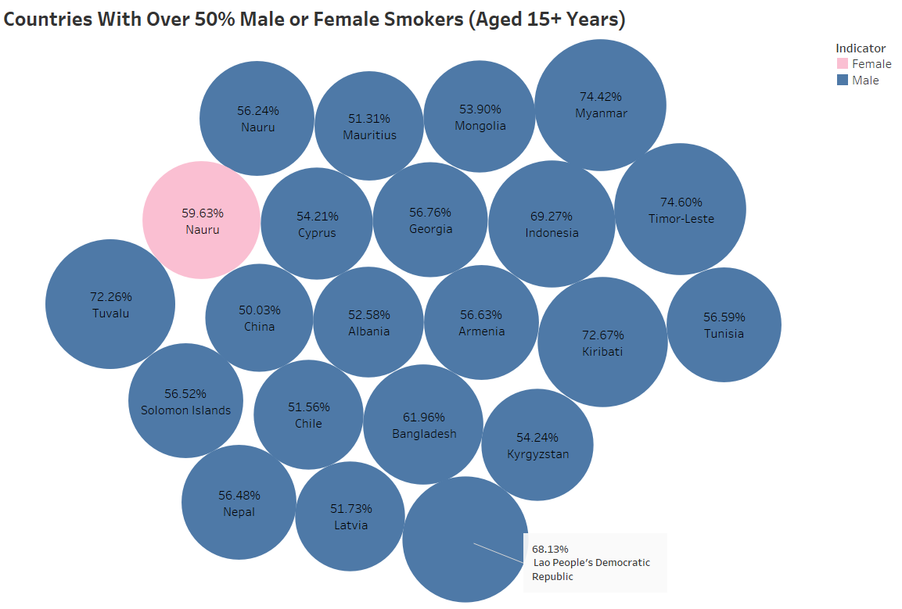
Smoking
Only Narau has over half its 15+y female population smoking tobacco

Slide 10
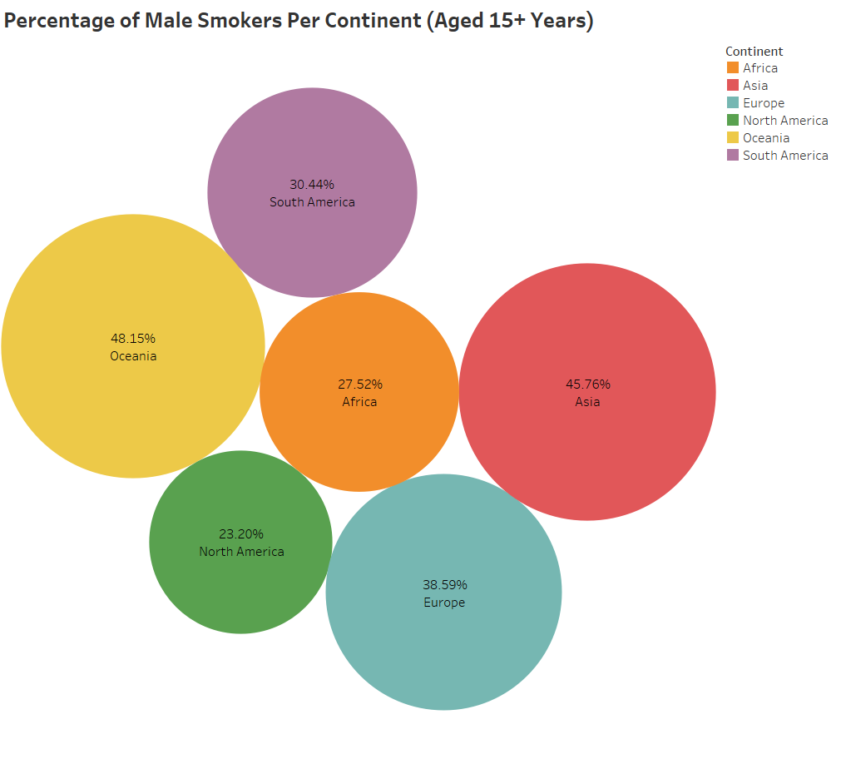
Smoking
Oceania leads with 48.15% male smokers
North America has the fewest male smokers

Slide 11
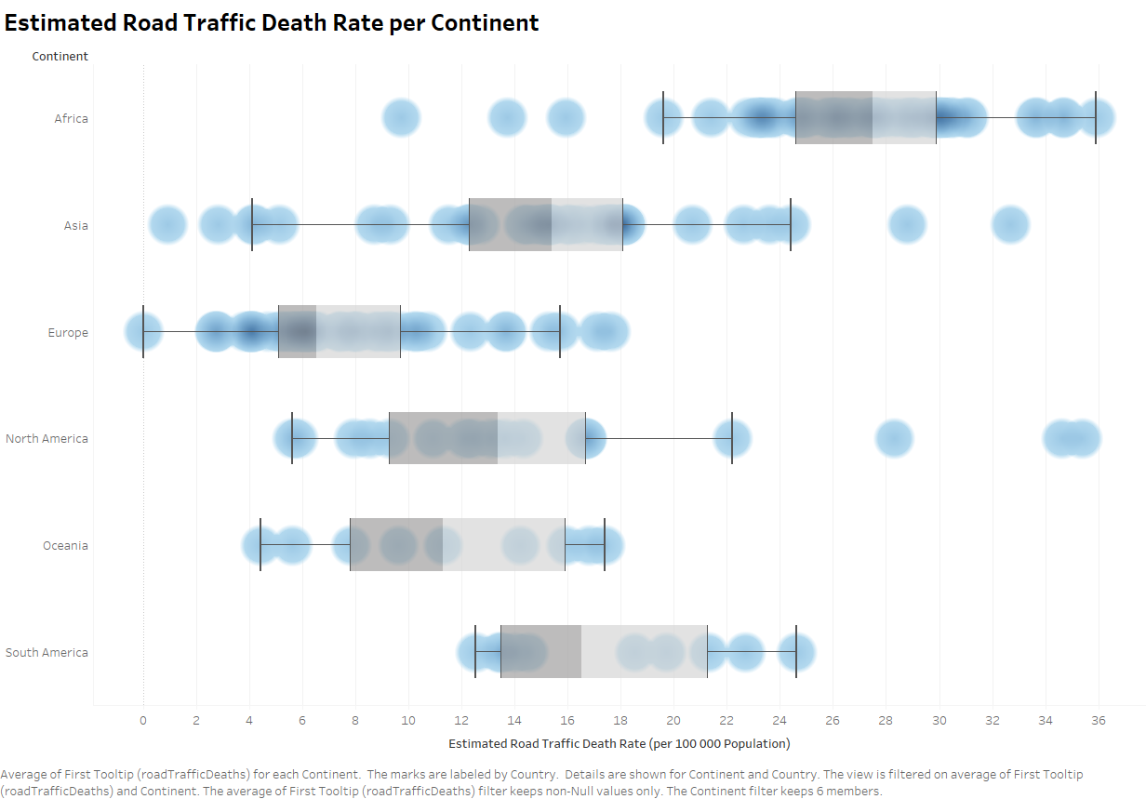
Road Traffic Safety
Asia has the most variability, South America has the least.

Slide 12
Disease, Mortality, and Life Expectancy

Slide 13
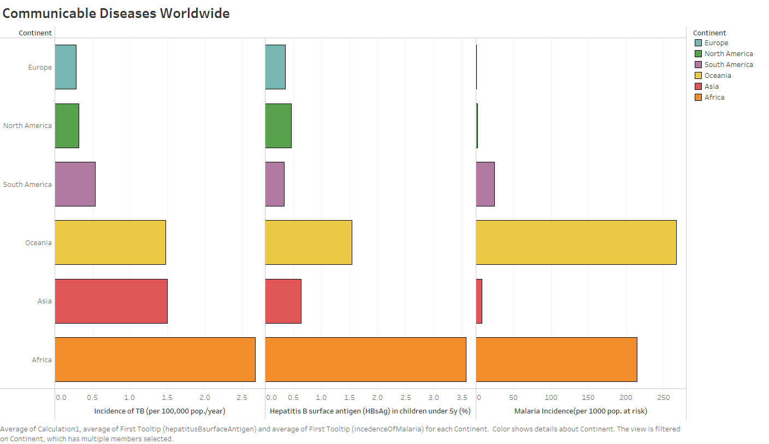
Disease and Mortality

Slide 14
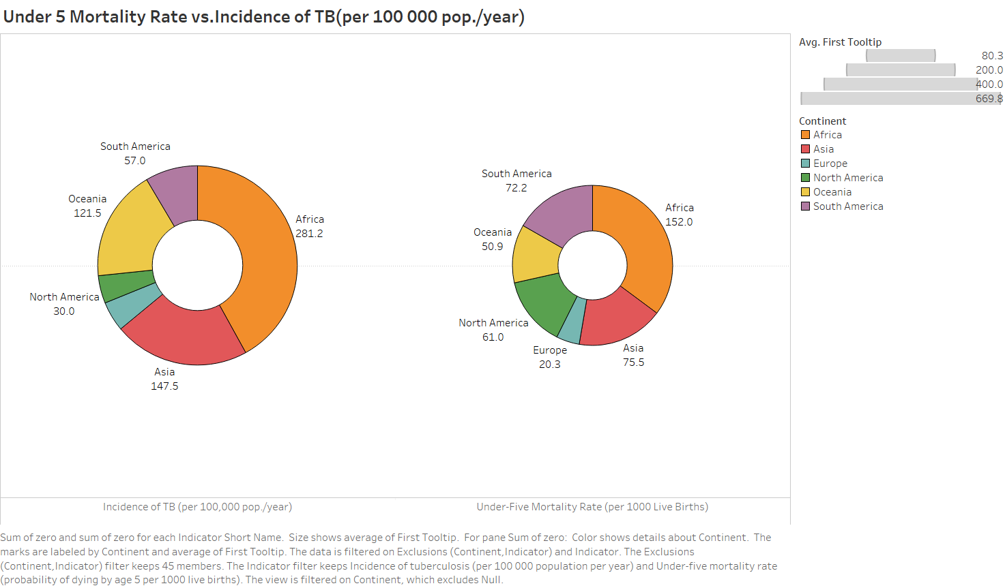
Disease and Mortality

Slide 15
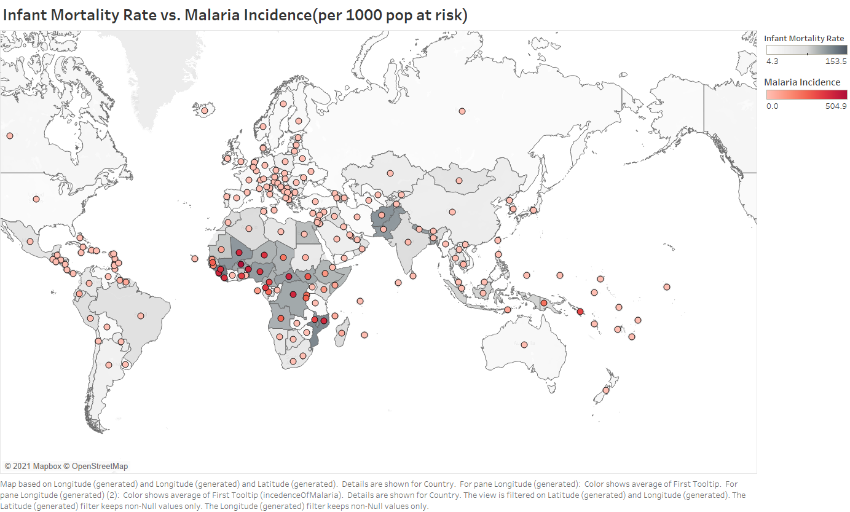
Disease and Mortality

Slide 16
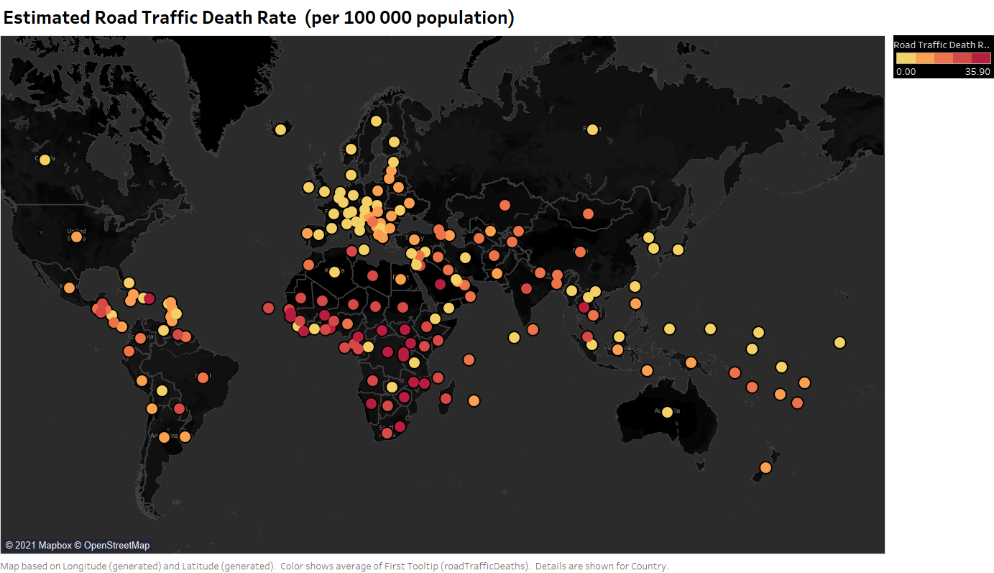
Disease and Mortality

Slide 17
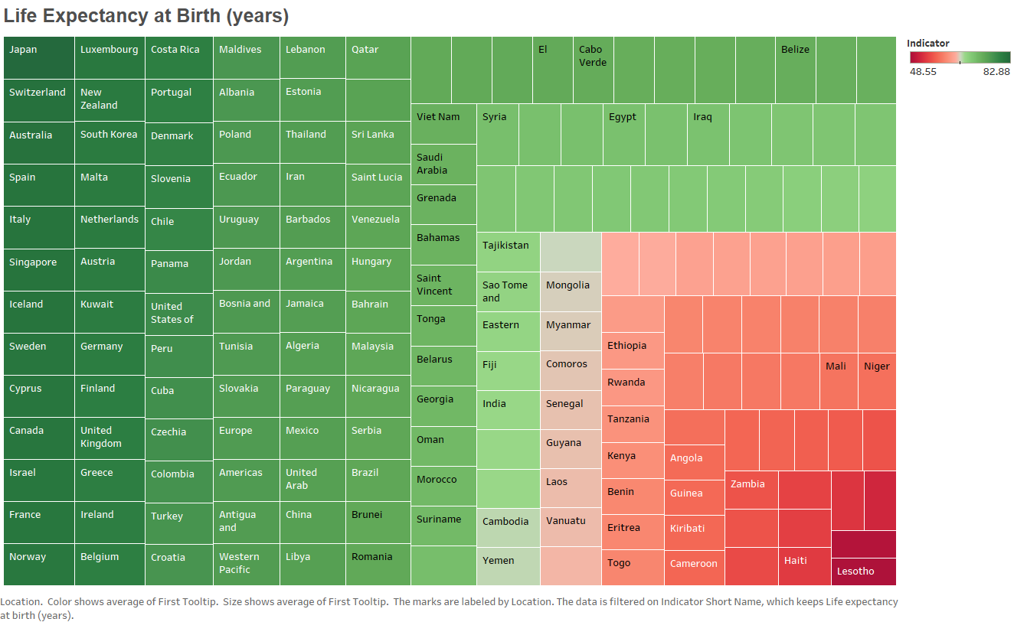

Slide 18
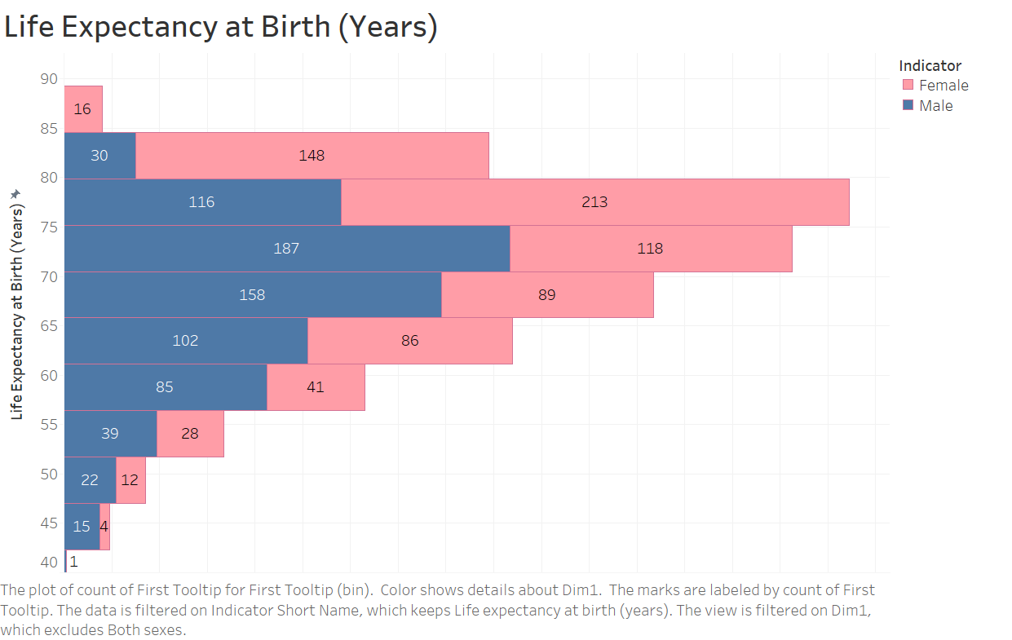
Are Women Expected to Live Longer?

Slide 19
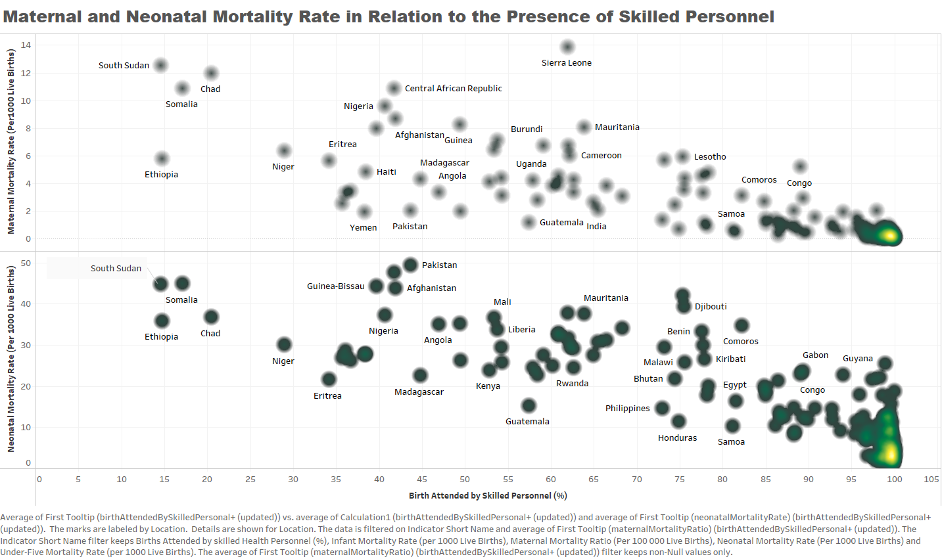
Are Nurses and Midwives Important?

Slide 20
A Closer Look
Chad, India, Bosnia and Herzegovina, and Canada
Selected based on PCA clusters

Slide 21
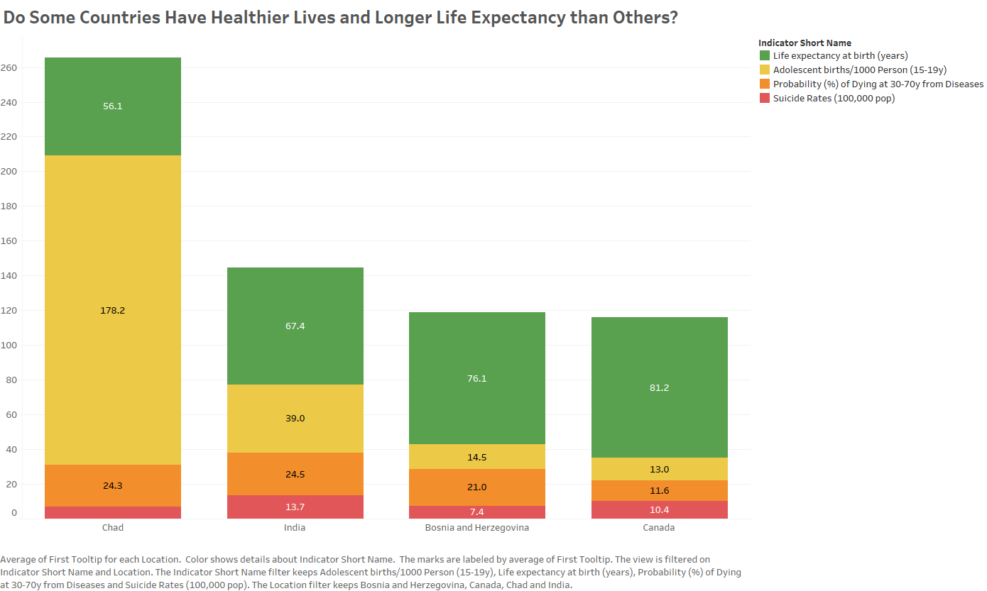

Slide 22
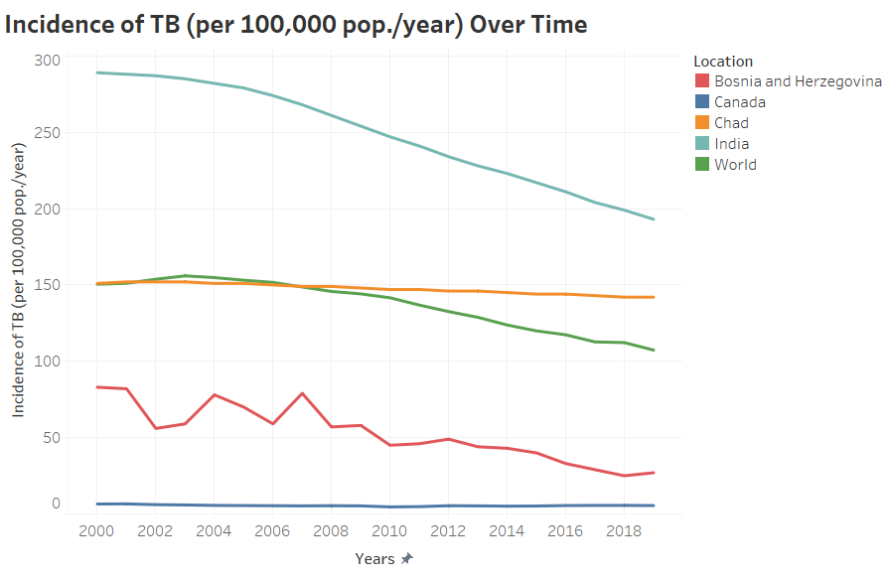
Tuberculosis

Slide 23
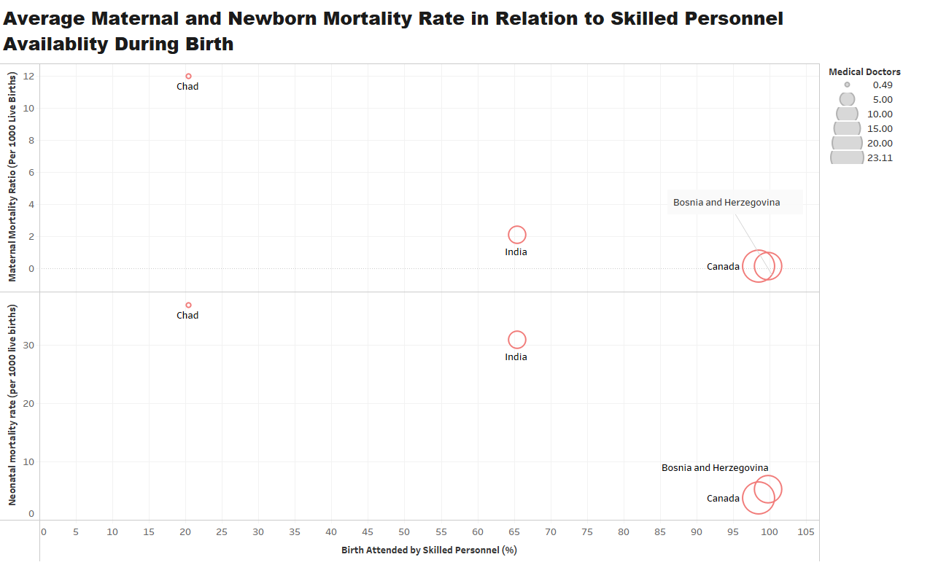

Slide 24
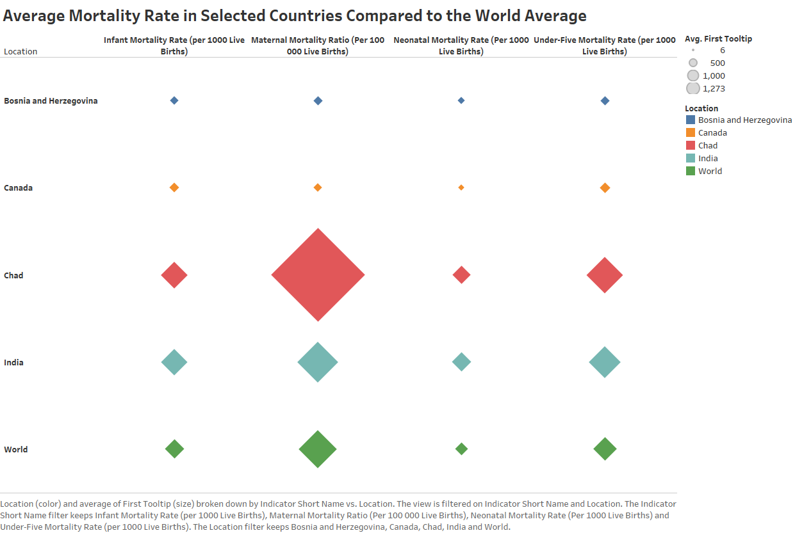

Slide 25
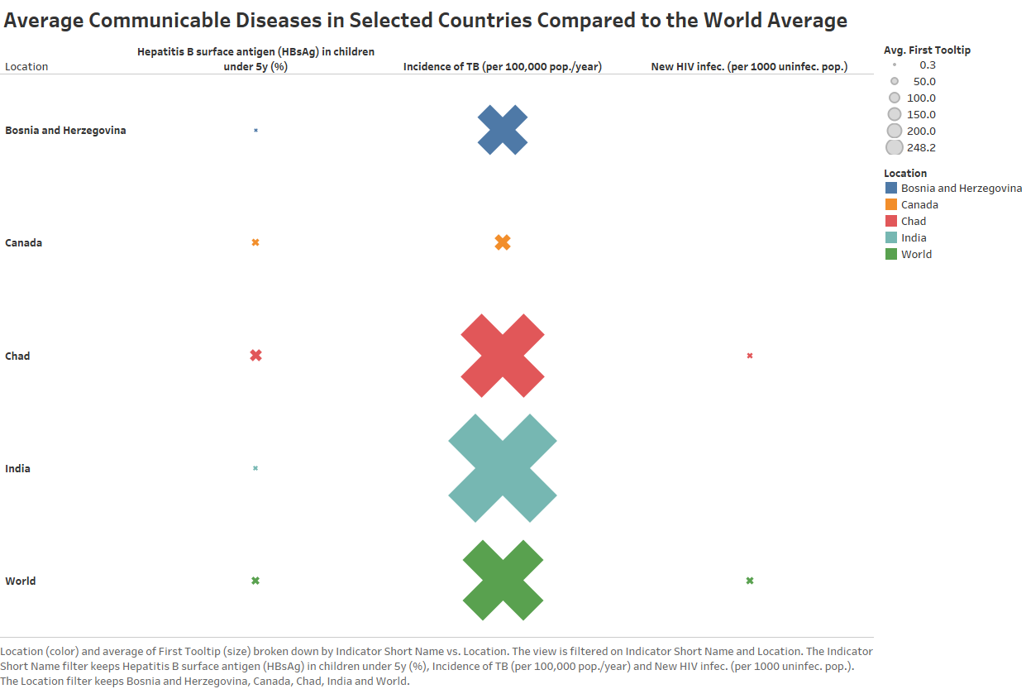

Slide 26
A Better Tomorrow

Slide 27
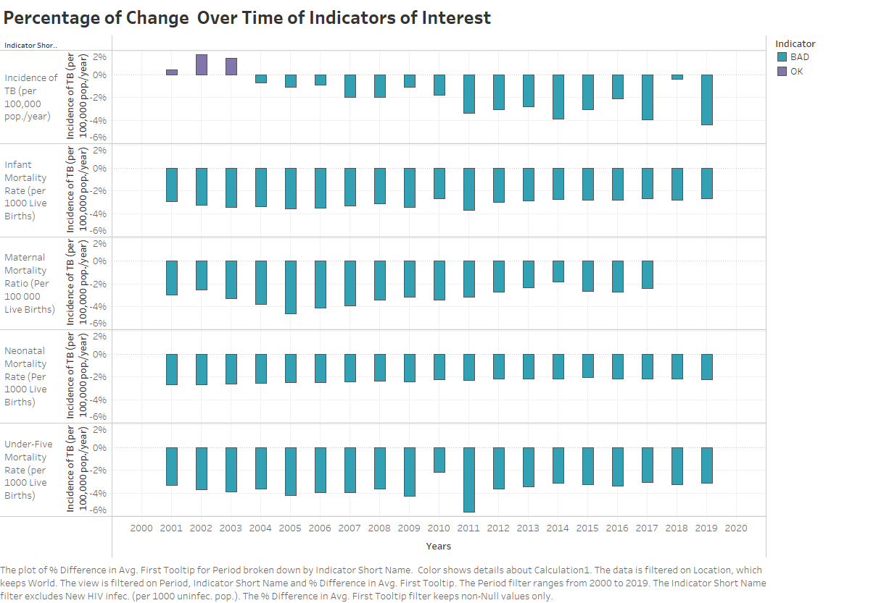

Slide 28
THANK YOU
#WEAREHST

Slide 29
Further Details

Slide 30
Issues with Data Set
Unavailable data
Gaps in data collection over the years
Discrepancies in country names across indicators (due to political events)

Slide 31
Data Preprocessing
Combined all files into
One file with multiple sheets
A single sheet
Performed PCA
Converted text into numerical values
Added Country-Continent table to map indicators to continents

